Slide 1
CS44/55: Data Science and Applied Machine Learning
Class Lecture: January 26th, 2023

Slide 2
Objectives
Last time:
Sorting and working with pandas DataFrames
Boolean Mask
.groupby method
Today:
Talk about data visualization
Matplotlib
Seaborn (Time permitting)

Slide 3
Data Visualization
Data visualization is an important area of study within data science
As data scientist/analyst we can learn amazing things from data
However, without the ability to communicate our findings our work has little meaning
Visualization is a tool we can use to help us deal with this issue

Slide 4
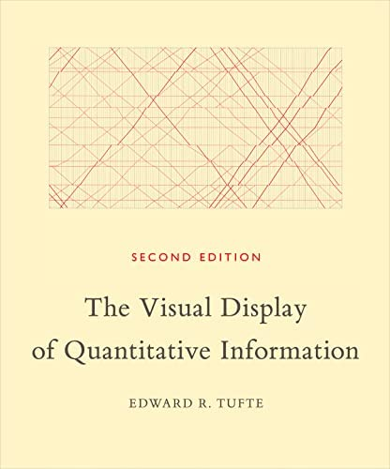
Data Visualization
Dr. Edward Tufte in his book The Visual Display of Quantitative Information wrote:
“Excellence in statistical graphics consists of complex ideas communicated with clarity, precision, and efficiency”

Slide 5
Data Visualization
The key takeaway should be that the ability to visualize our data adds a lot of value to our work
Humans generally can gain a lot more knowledge through graphics, then just text
Tools like Matlab and R are popular in science, in part due to their ability to create high quality visualization
While Python doesn’t have the visualization functionality as other tools it is quickly catching up
We will go over two popular visualization tools: Matplotlib & Seaborn

Slide 6

Matplotlib
Matplotlib is a free open-source Python package with a variety of different visualization capabilities
Matplotlib is designed to work with common data science structures The designers of Matplotlib wanted the package to function similar to MATLAB, but with the benefit that it would open
Matplotlib is the basis for many other visualization packages in Python, such as Seaborn and Basemap
Matplotlib also has functionality to help it work with Microsoft Excel and LaTeX(tikzplotlib)

Slide 7
Plotting With Matplotlib
There are a number of useful basic graphs we can plot with Matplotlib:
Basic line plot
Scatterplots
Histograms
Bar plots
Pie Charts
Let’s go over all of these in Colab

Slide 8
Histograms Vs. Bar Graphs
Histograms and bar graphs often get confused with one another
Histograms are used when wanting to measuring frequency
When working with Histograms keep in mind that order is important and cannot be changed
Bar graphs are used for comparisons between different categories and order can be change
Keep these rules in mind when choosing how to visualize your data

Slide 9
Next Time
Continue visualization with Seaborn
Data visualization with pandas
Go over filters, .loc and .iloc with pandas
Homework 2 is due on 2/01 before class

